Slide 1
Using Ancestry.com
by Barbara Branch

Slide 2
Features of Ancestry.com
The World’s Largest
Genealogy Database
3 million paying subscribers
100 million family trees containing more than 11 billion ancestral profiles
> 1 billion searches monthly
Contains more then 20.0 billion records/6 billion USA Records
Access to records from USA, UK, Ireland, Canada and many more countries
Records back to 13th century
Updated daily with thousands of entries
15 Million people in DNA network

Slide 3
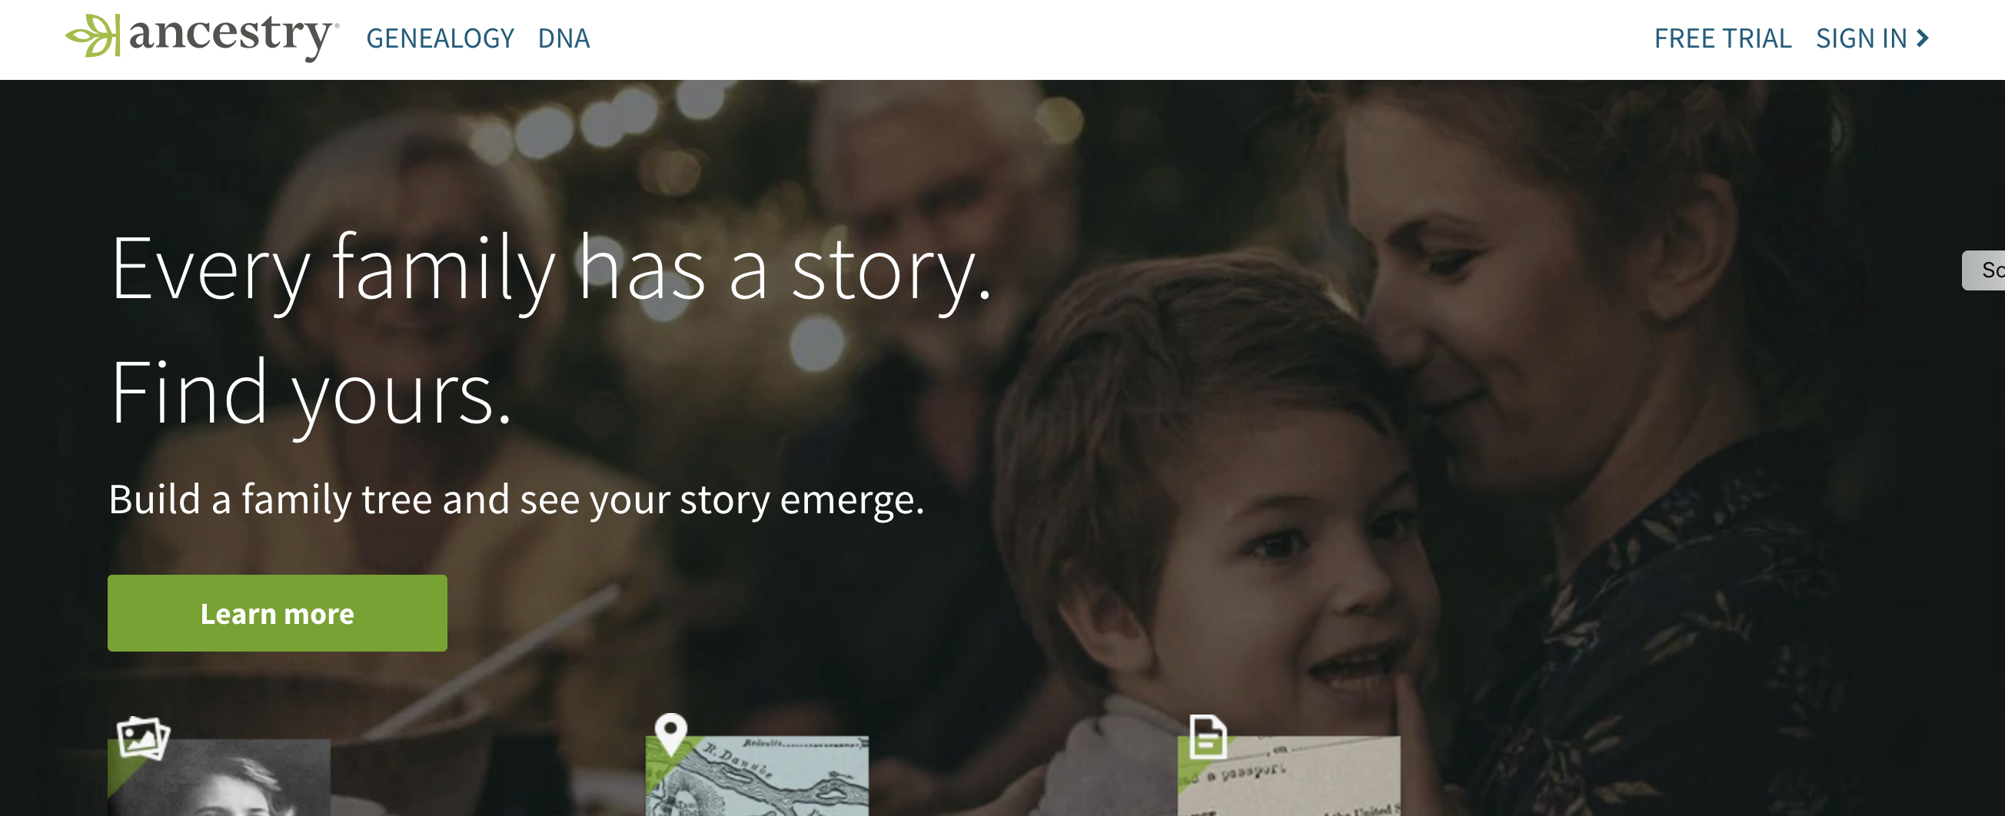

Slide 4
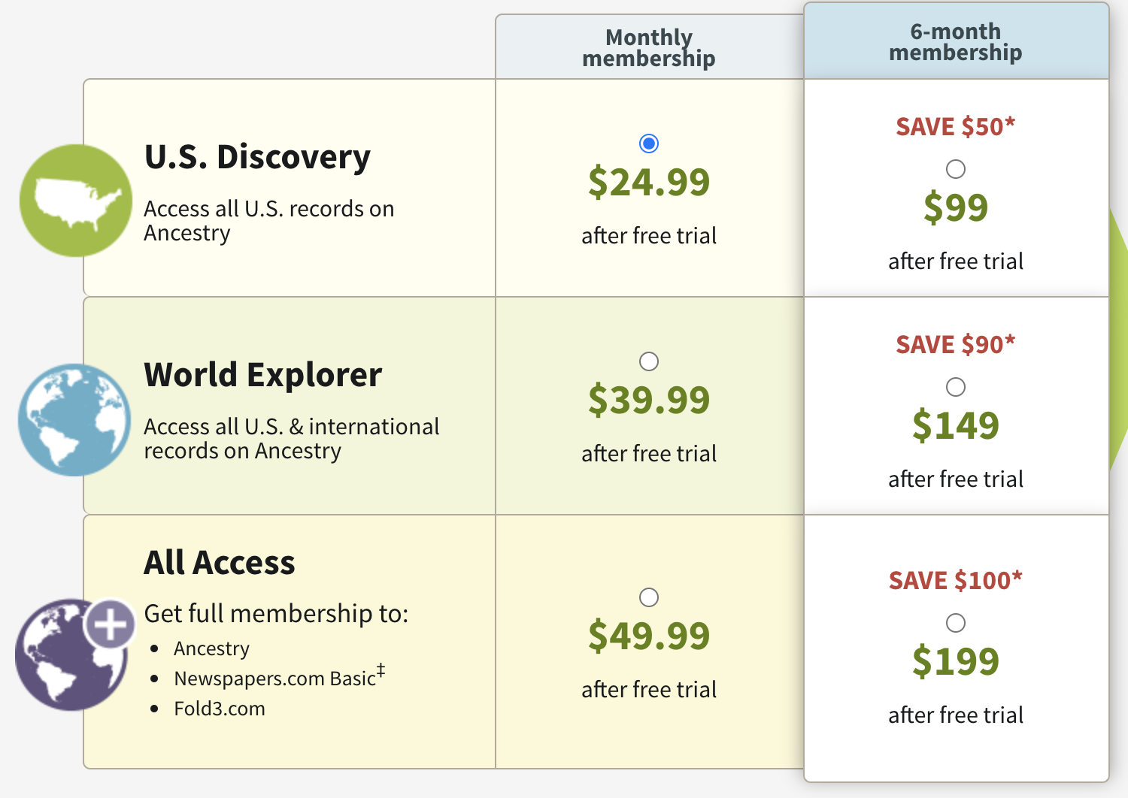
Ancestry.com’s Membership Costs
Basic membership is free (a valid email address is required).
Watch website for deals, especially around holidays

Slide 5
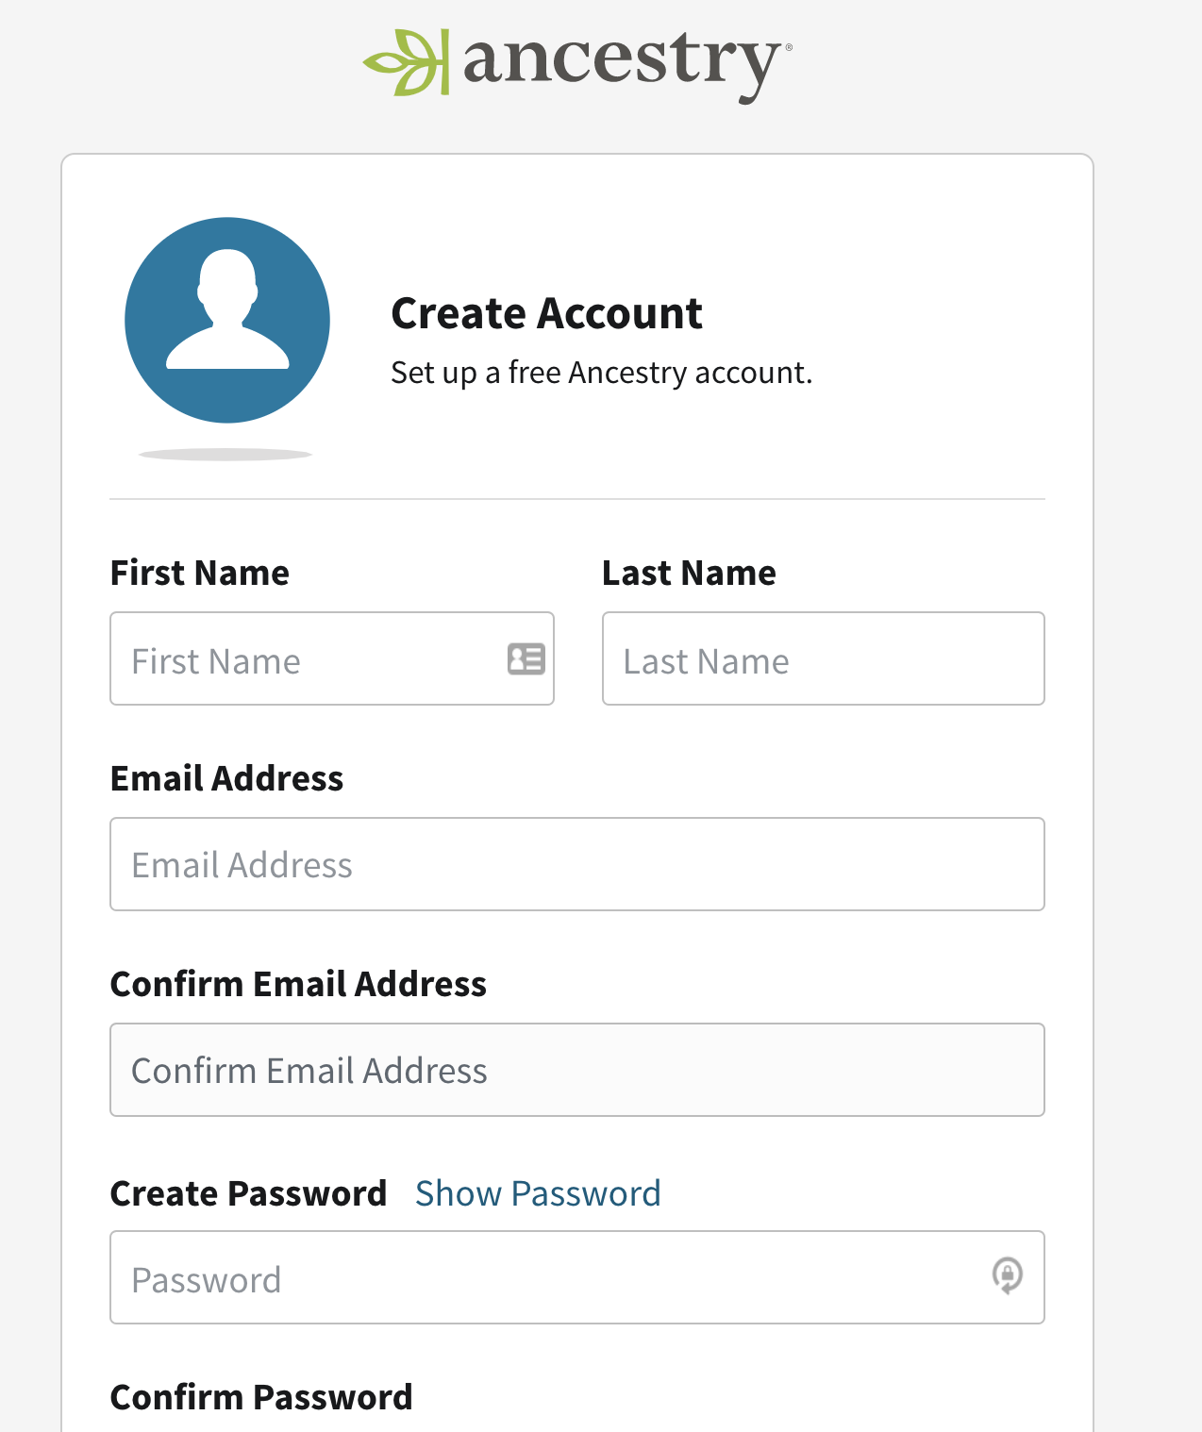
Register for Free to Ancestry.com

Slide 6
What is available in the free account?
Access free databases
(If you have a DNA test) activate your DNA test
(If you have a DNA test) view your DNA ethnicity estimate and DNA matches
View the DNA results of anyone who invites you to see theirs
Create, edit, and delete family trees
View educational videos in Ancestry Academy
Share trees with friends and family
View family trees to which you're invited
Respond to messages from other members
Post to Ancestry Message Boards
Read tips from our experts on the Ancestry Blog

Slide 7
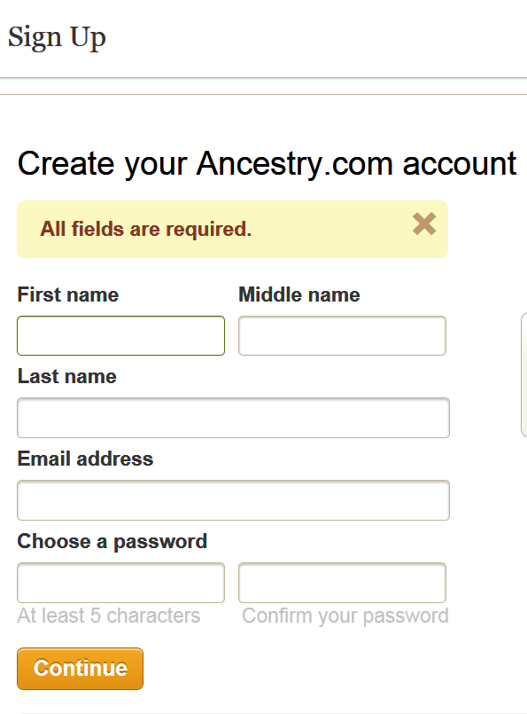
Create Ancestry.com Account

Slide 8
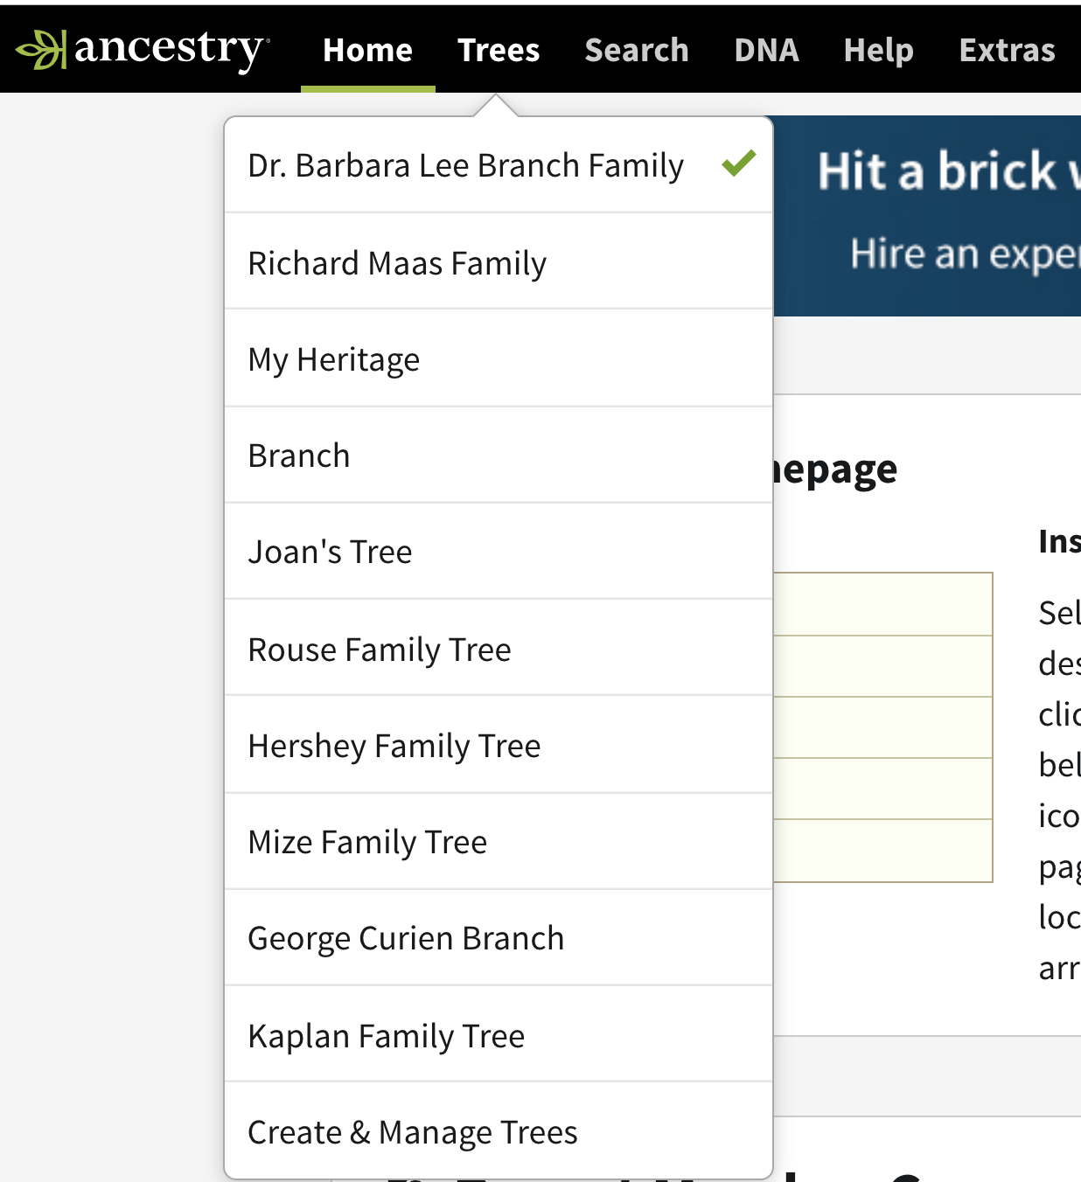
Create and Manage Trees
You can have as many trees as you want.
Many people make different trees for each branch of the family rather than one big tree.

Slide 9
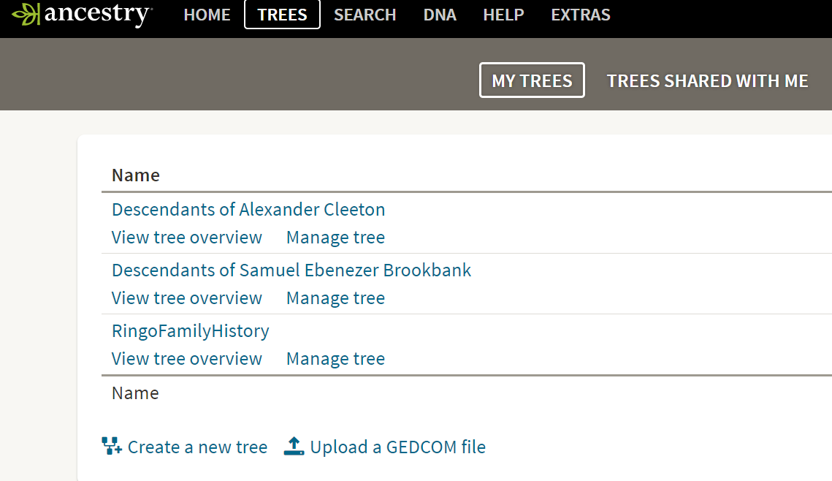
Create New Tree & Upload GEDCOM

Slide 10
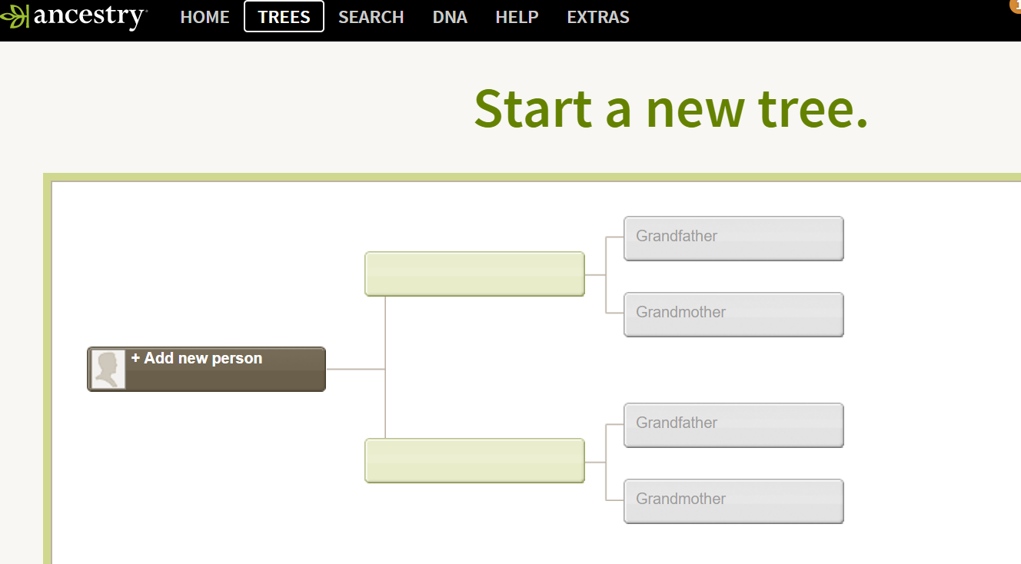

Slide 11
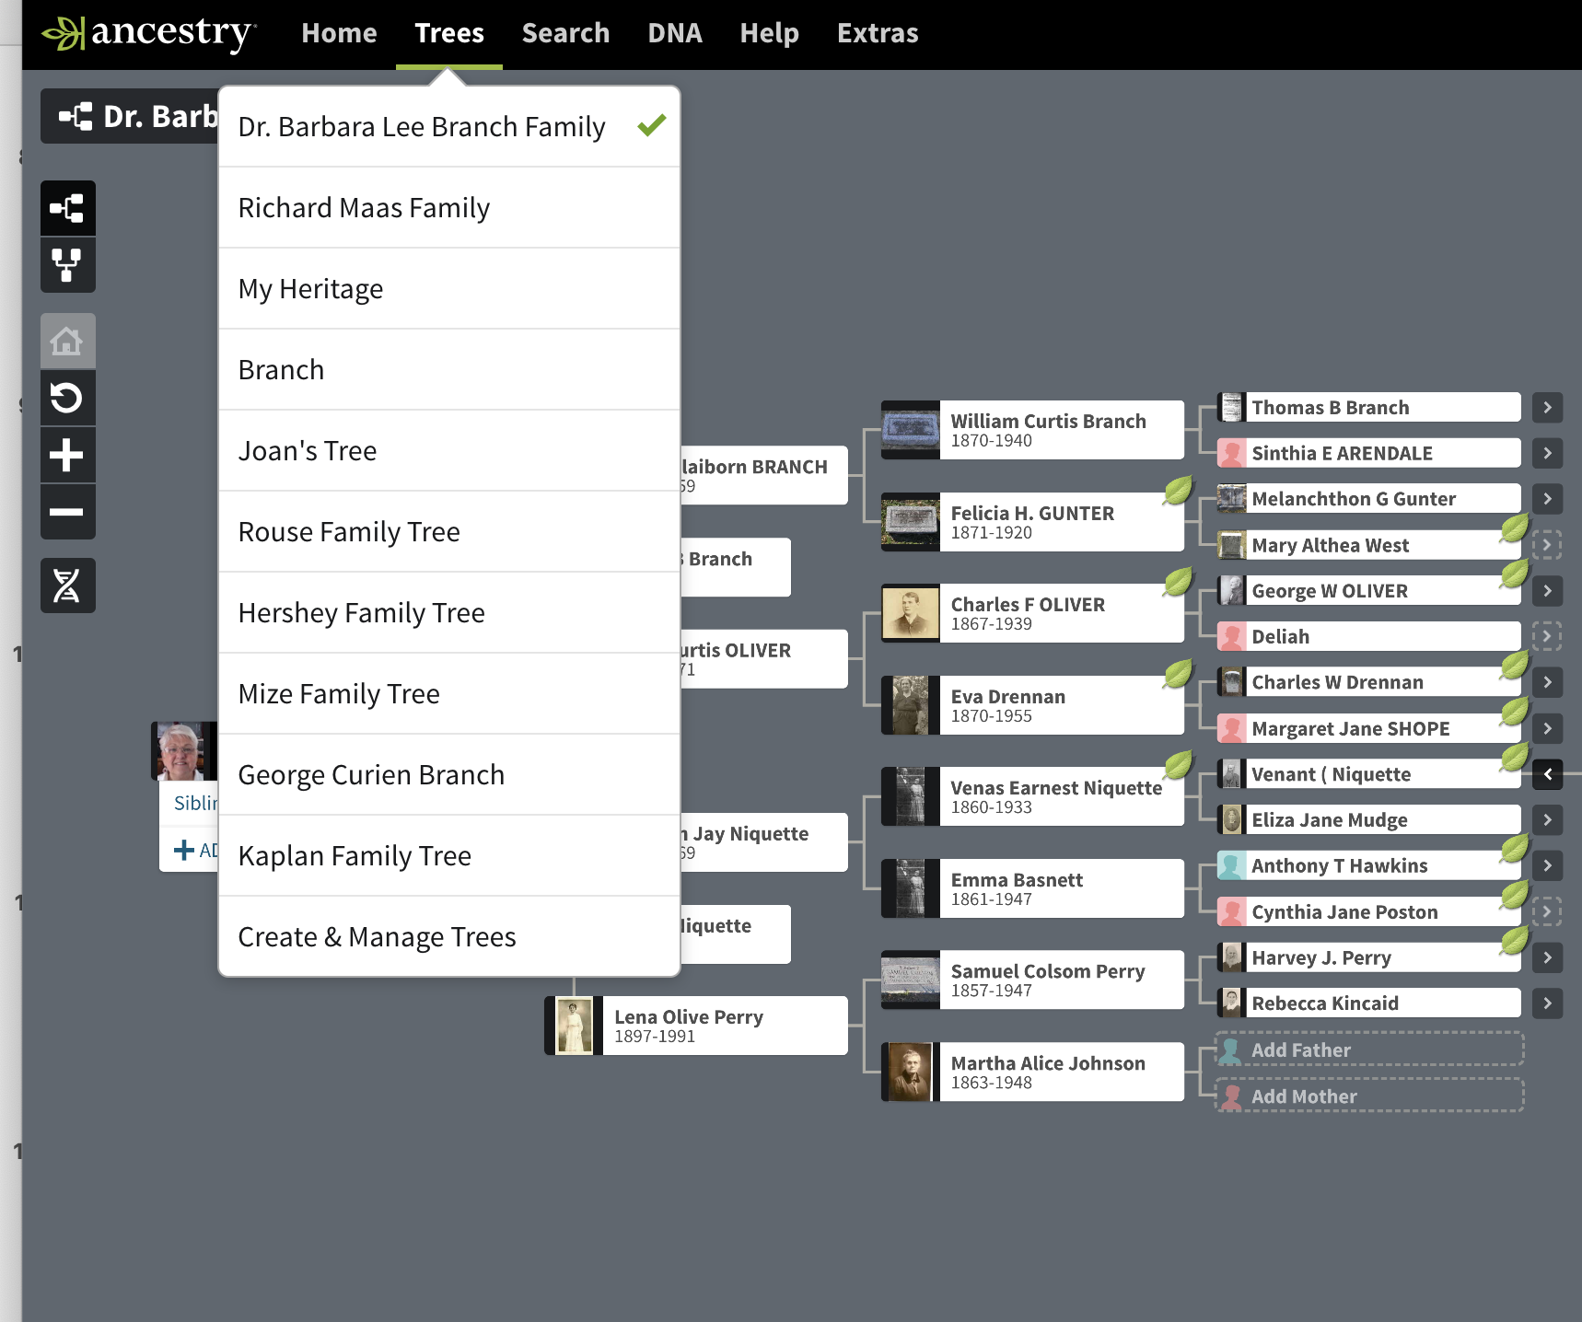
Family Trees – Pedigree View
Choose
Dr. Barbara Lee Branch

Slide 12
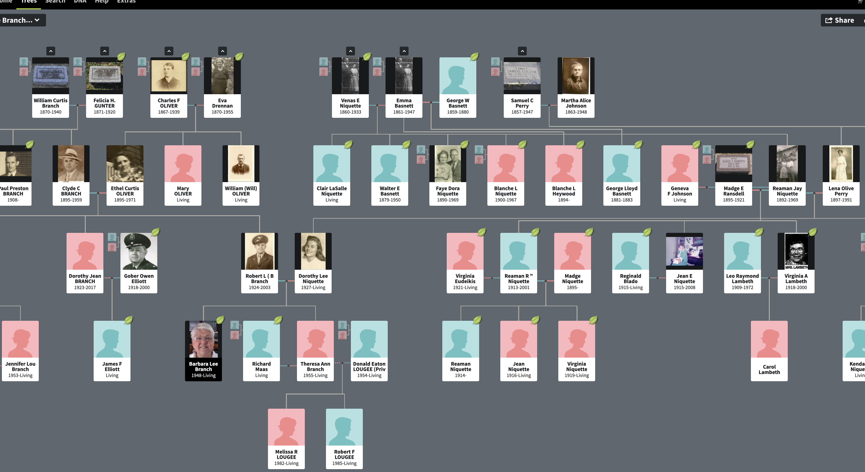
Family View

Slide 13
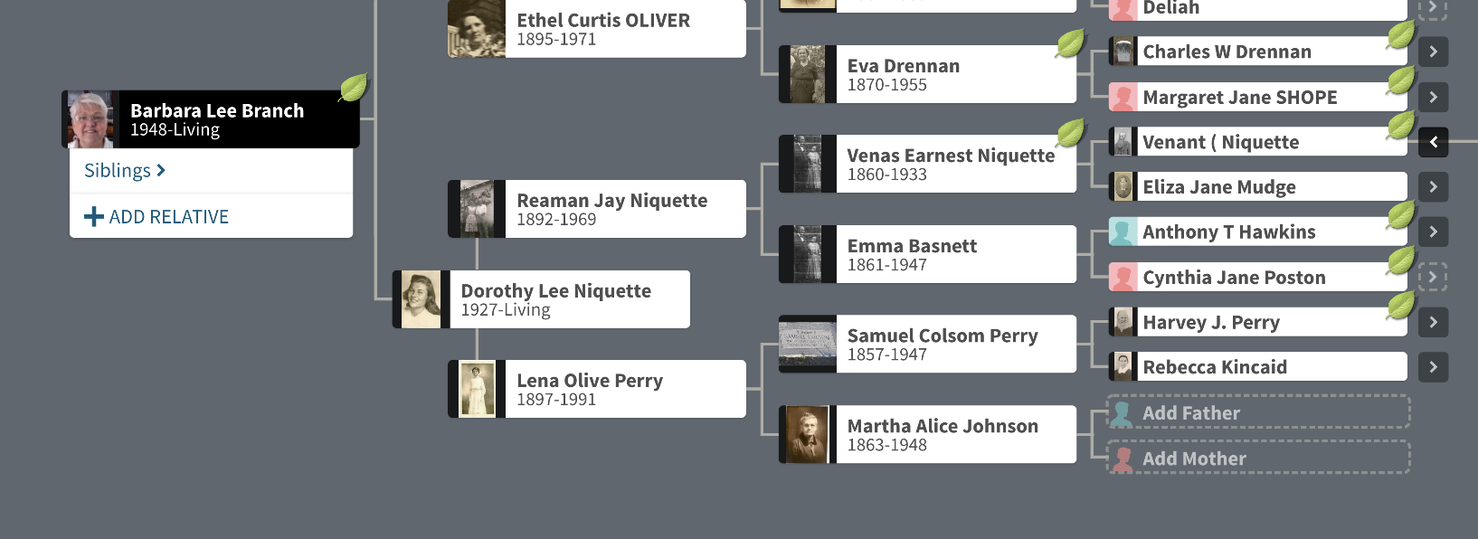
Adding To A Family Tree From Tree
Add relative
Add father

Slide 14
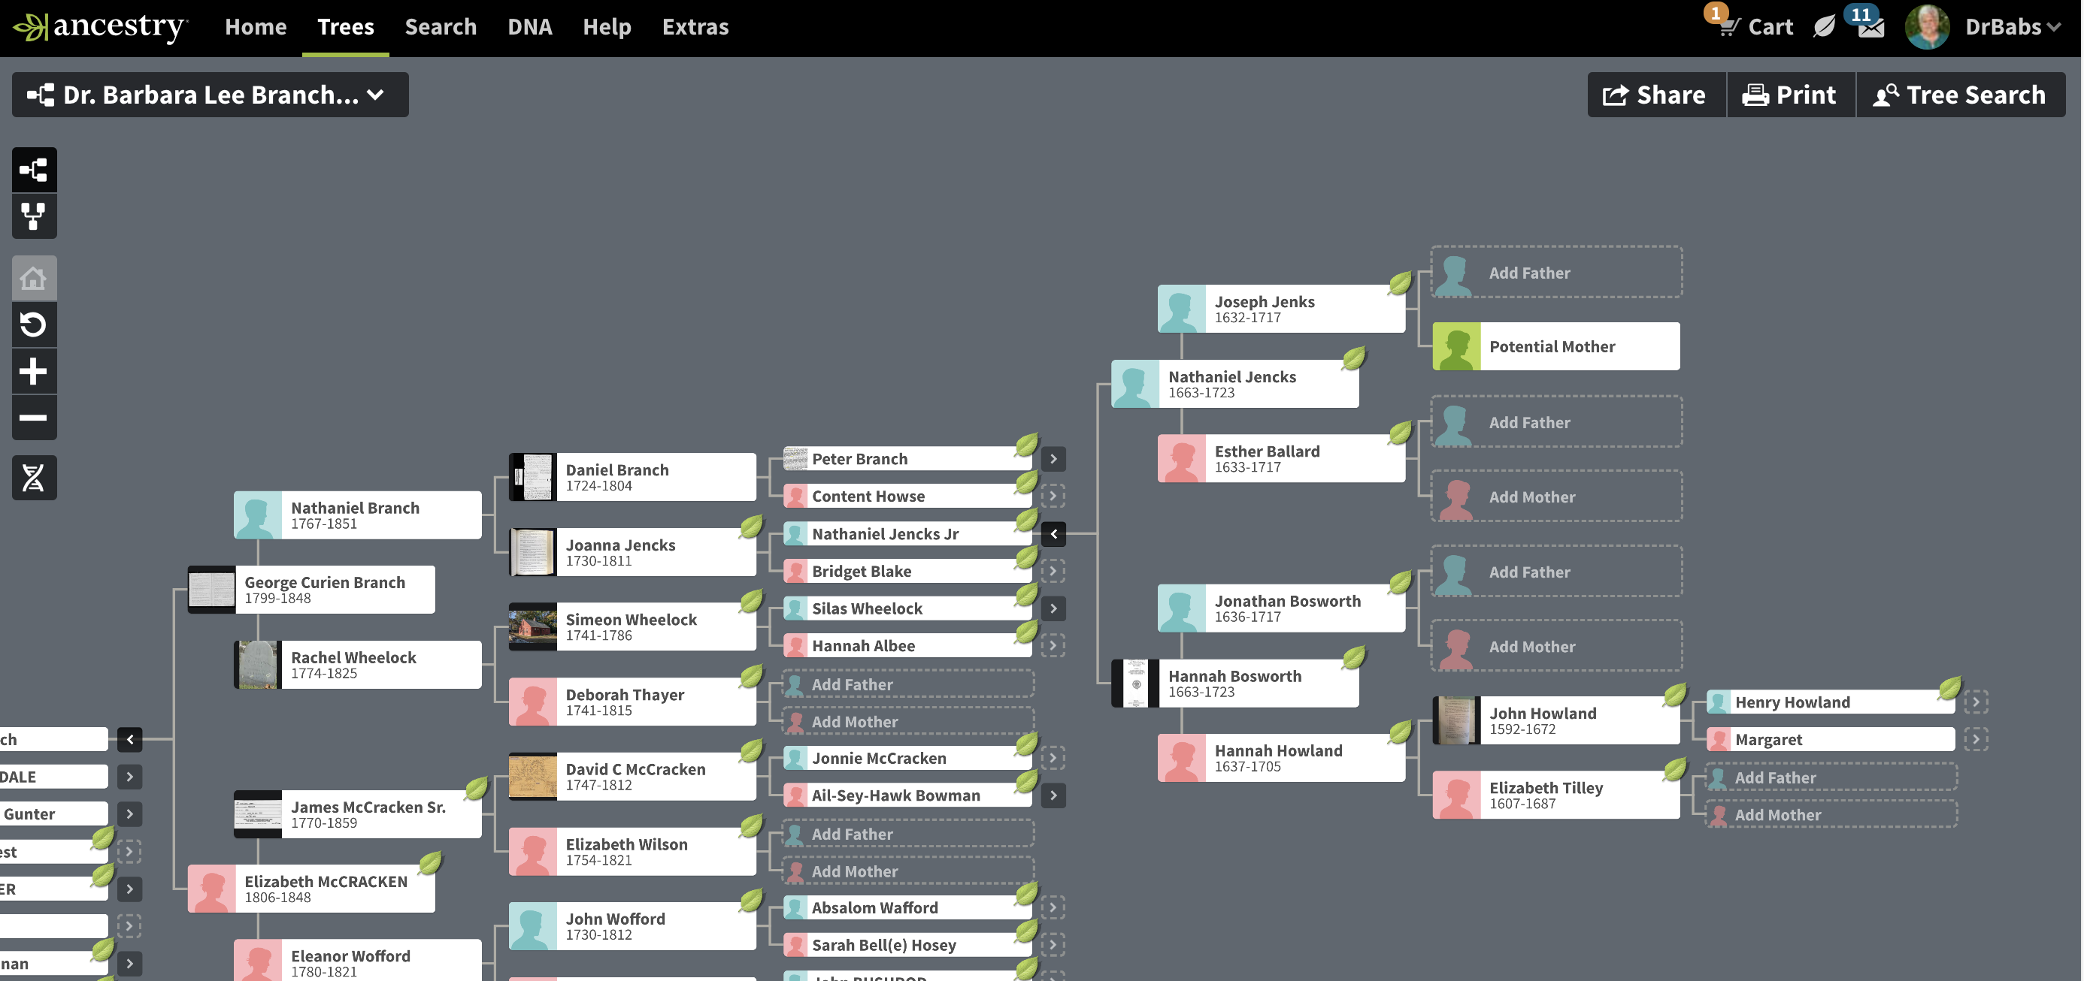
Individual Profile
Click on Individual

Slide 15
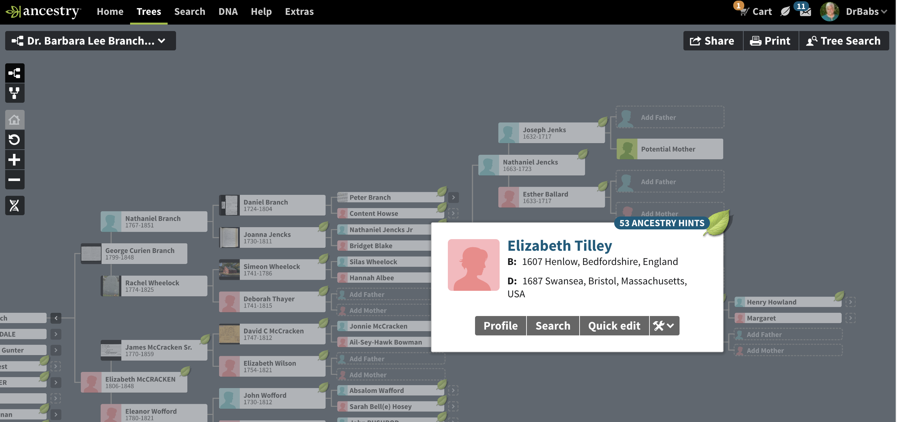
Individual Profile
Click on Profile

Slide 16
Individual Profile
Check Hints
View Lifestory
View by facts
Add photos, other attachments

Slide 17
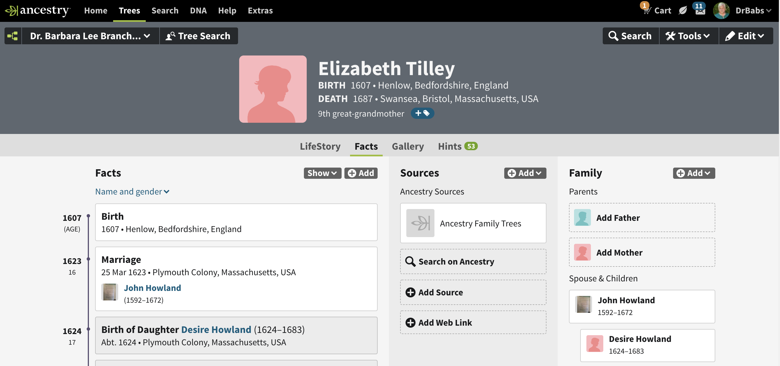
Facts View

Slide 18
Lifestory View

Slide 19
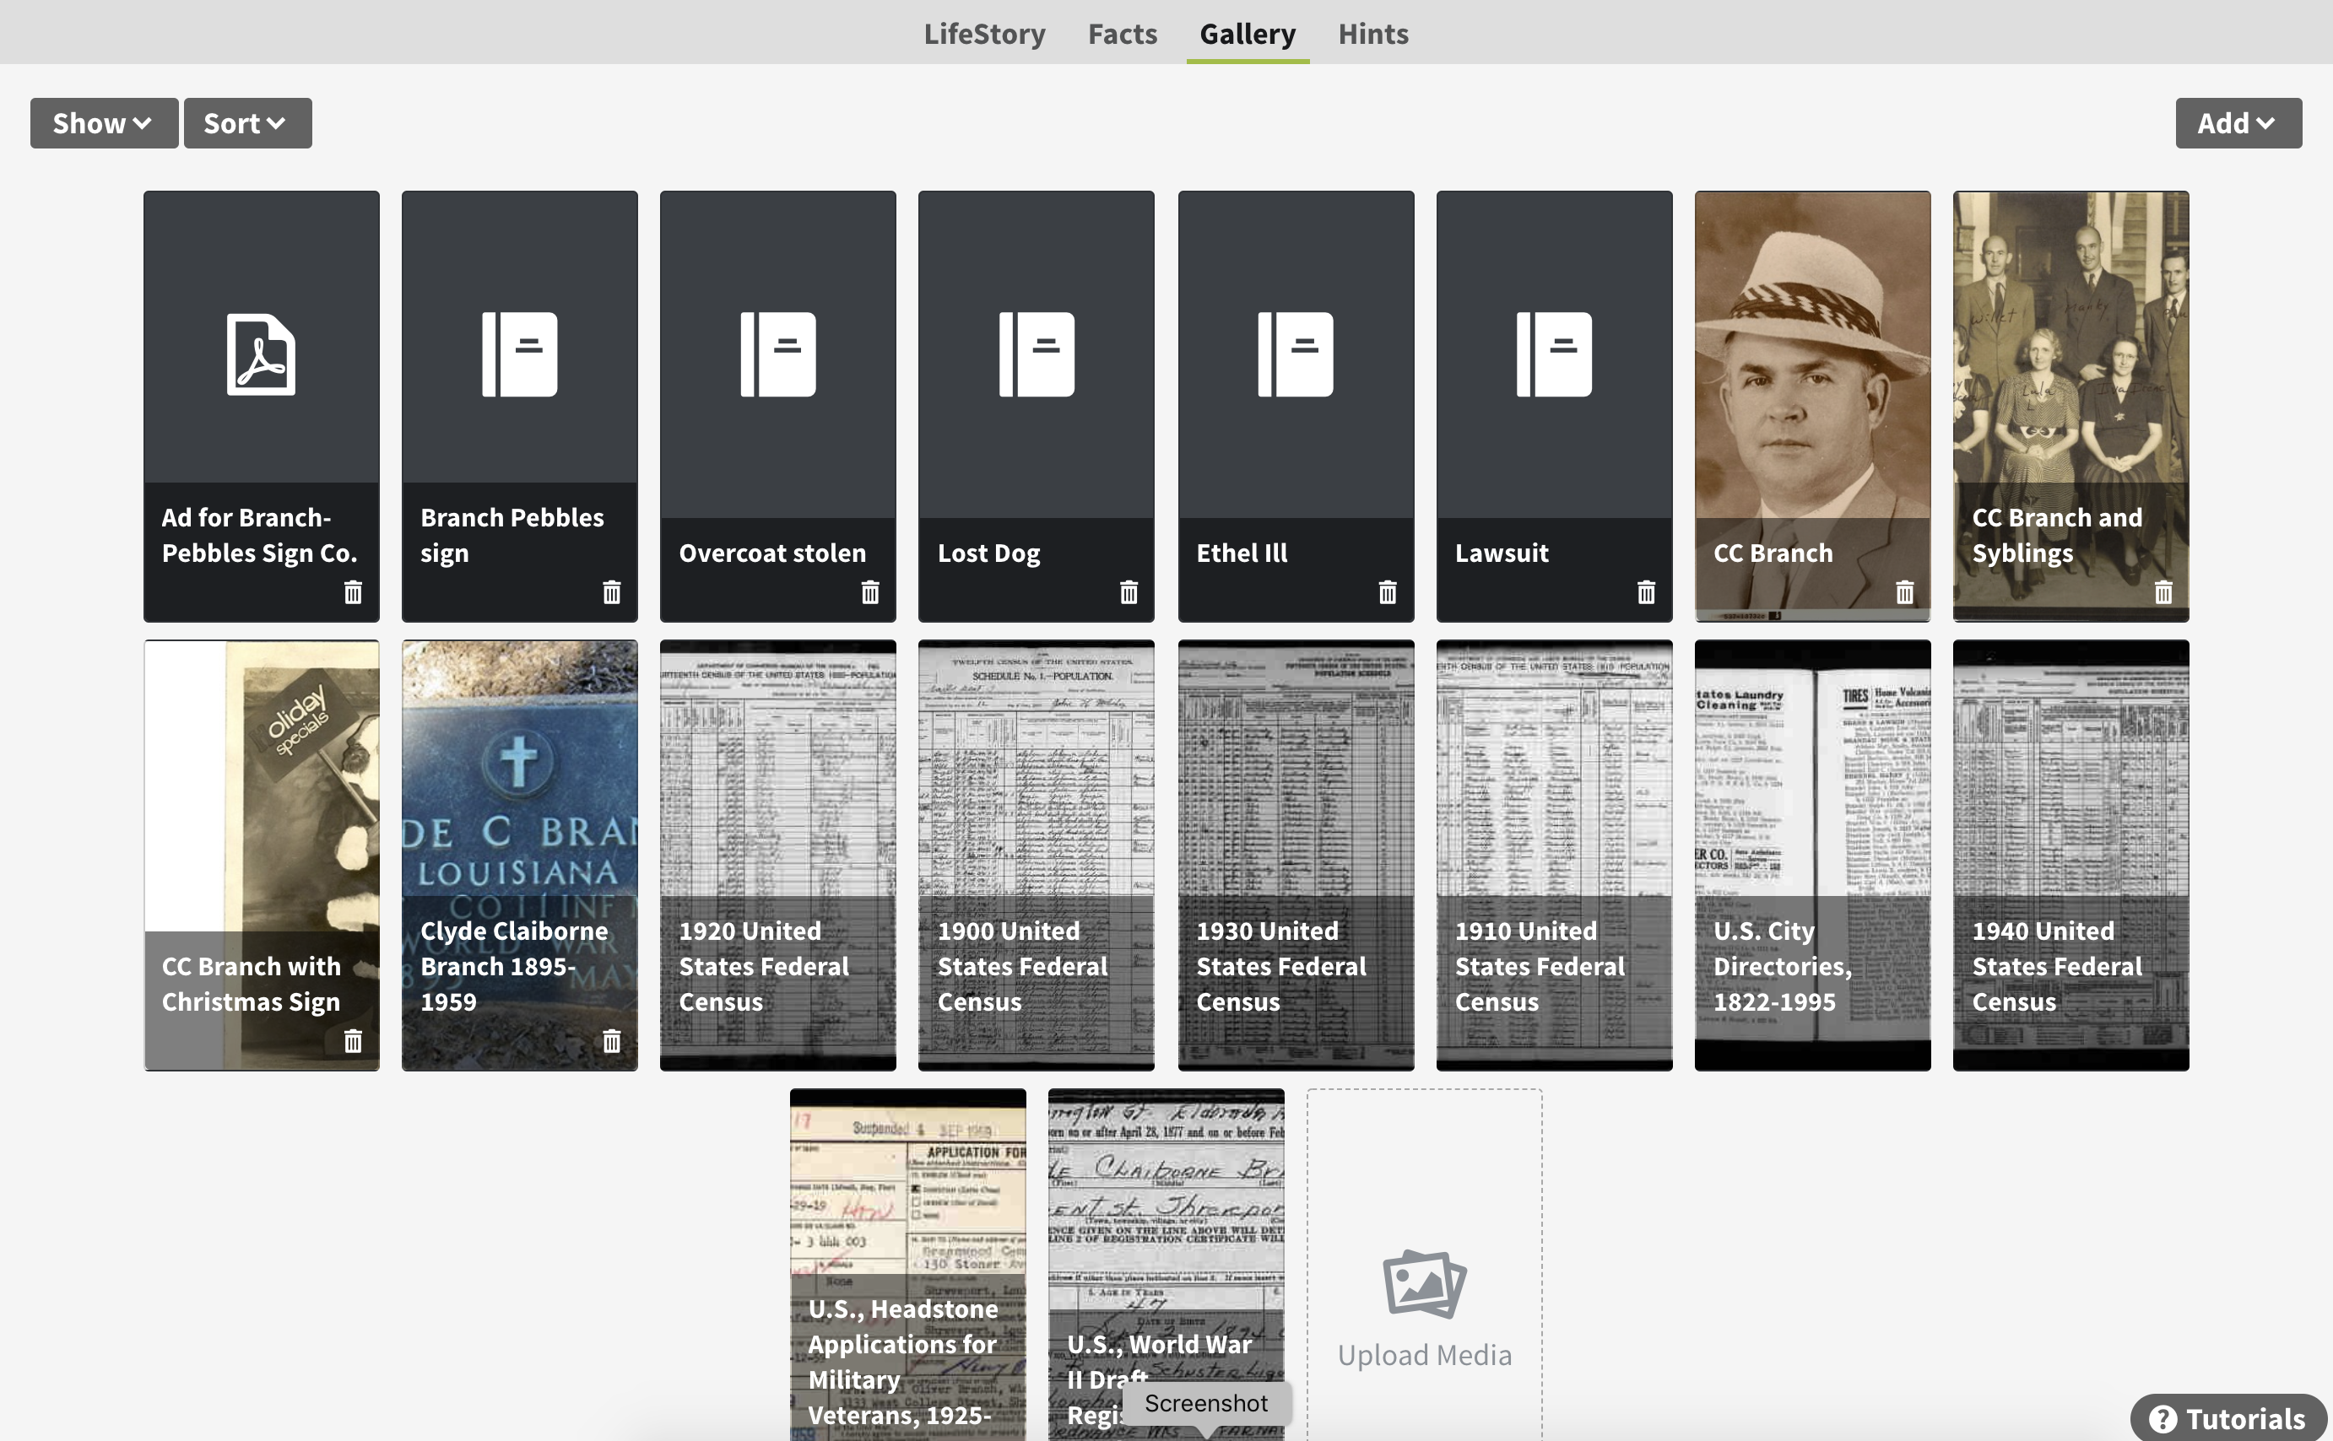
Gallery
Click on Upload Media

Slide 20
Tools Menu

Slide 21
Adding To A Family Tree From Profile
Add father

Slide 22
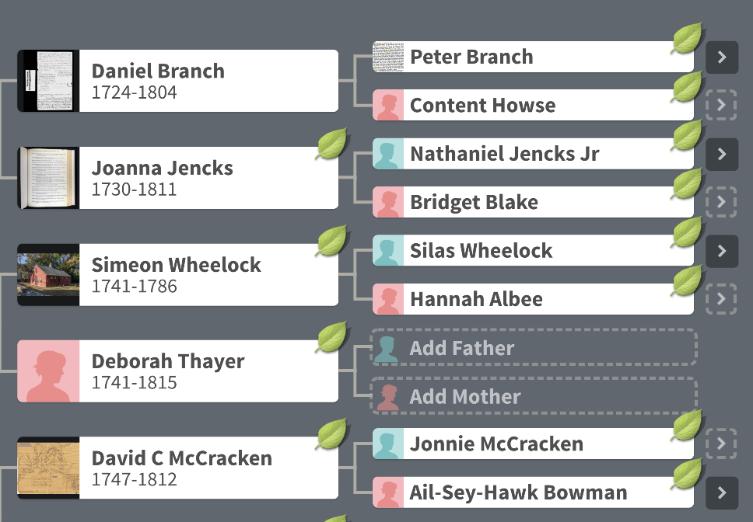
Wavy Leaves - Hints

Slide 23
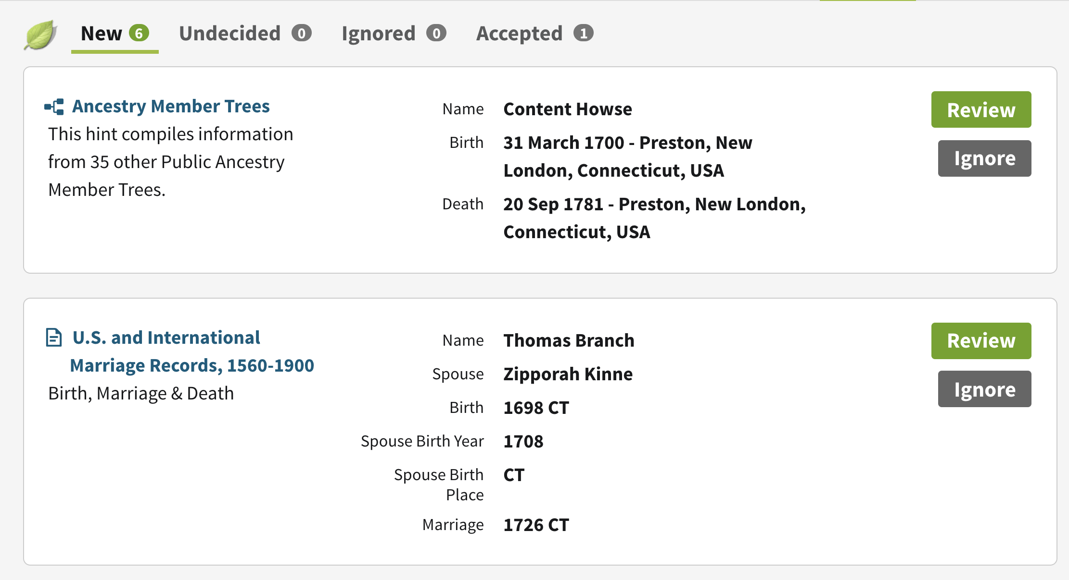
Hints

Slide 24
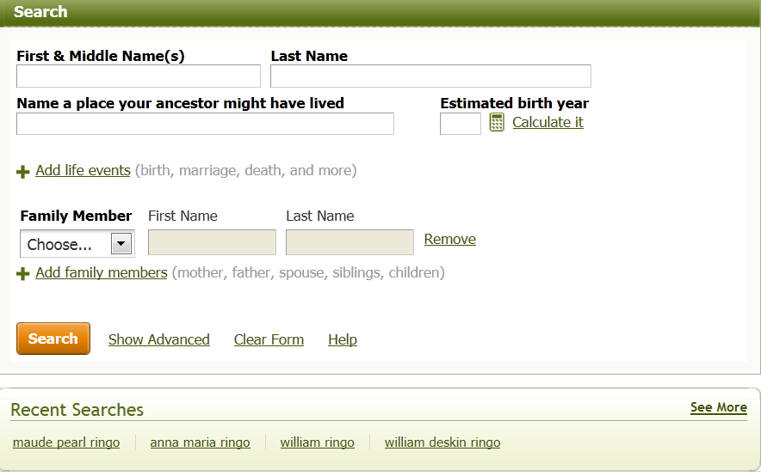
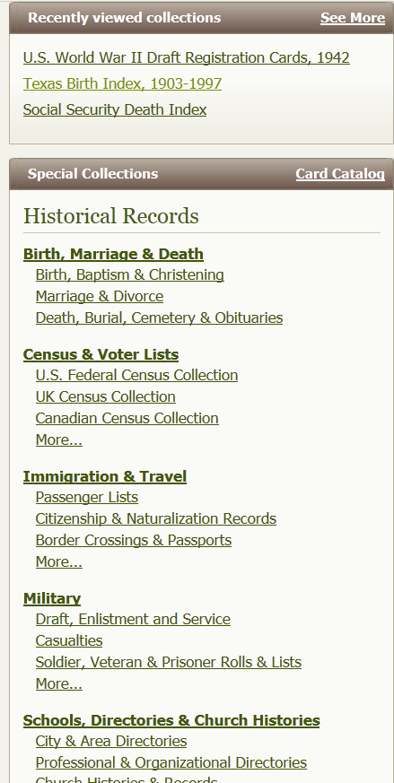
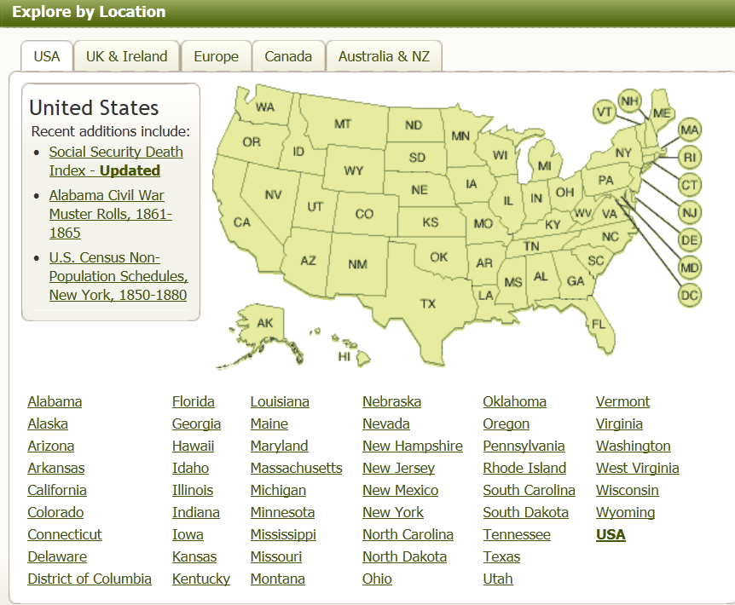
Ancestry.com “Search”

Slide 25
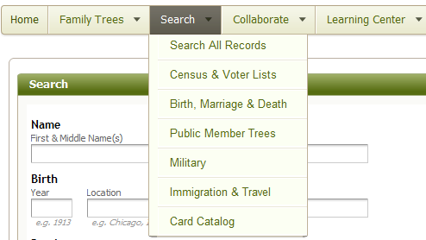
Ancestry.com’s “Search” Methodology
Hover your cursor over the Search tab at the top of most pages on Ancestry.com.
A drop down box will appear, and you can choose to search from the following options:
■Search All Records
■Census & Voter Lists
■Birth, Marriage & Death
■Public Member Trees
■Military
■Immigration & Emigration
■Card Catalog

Slide 26
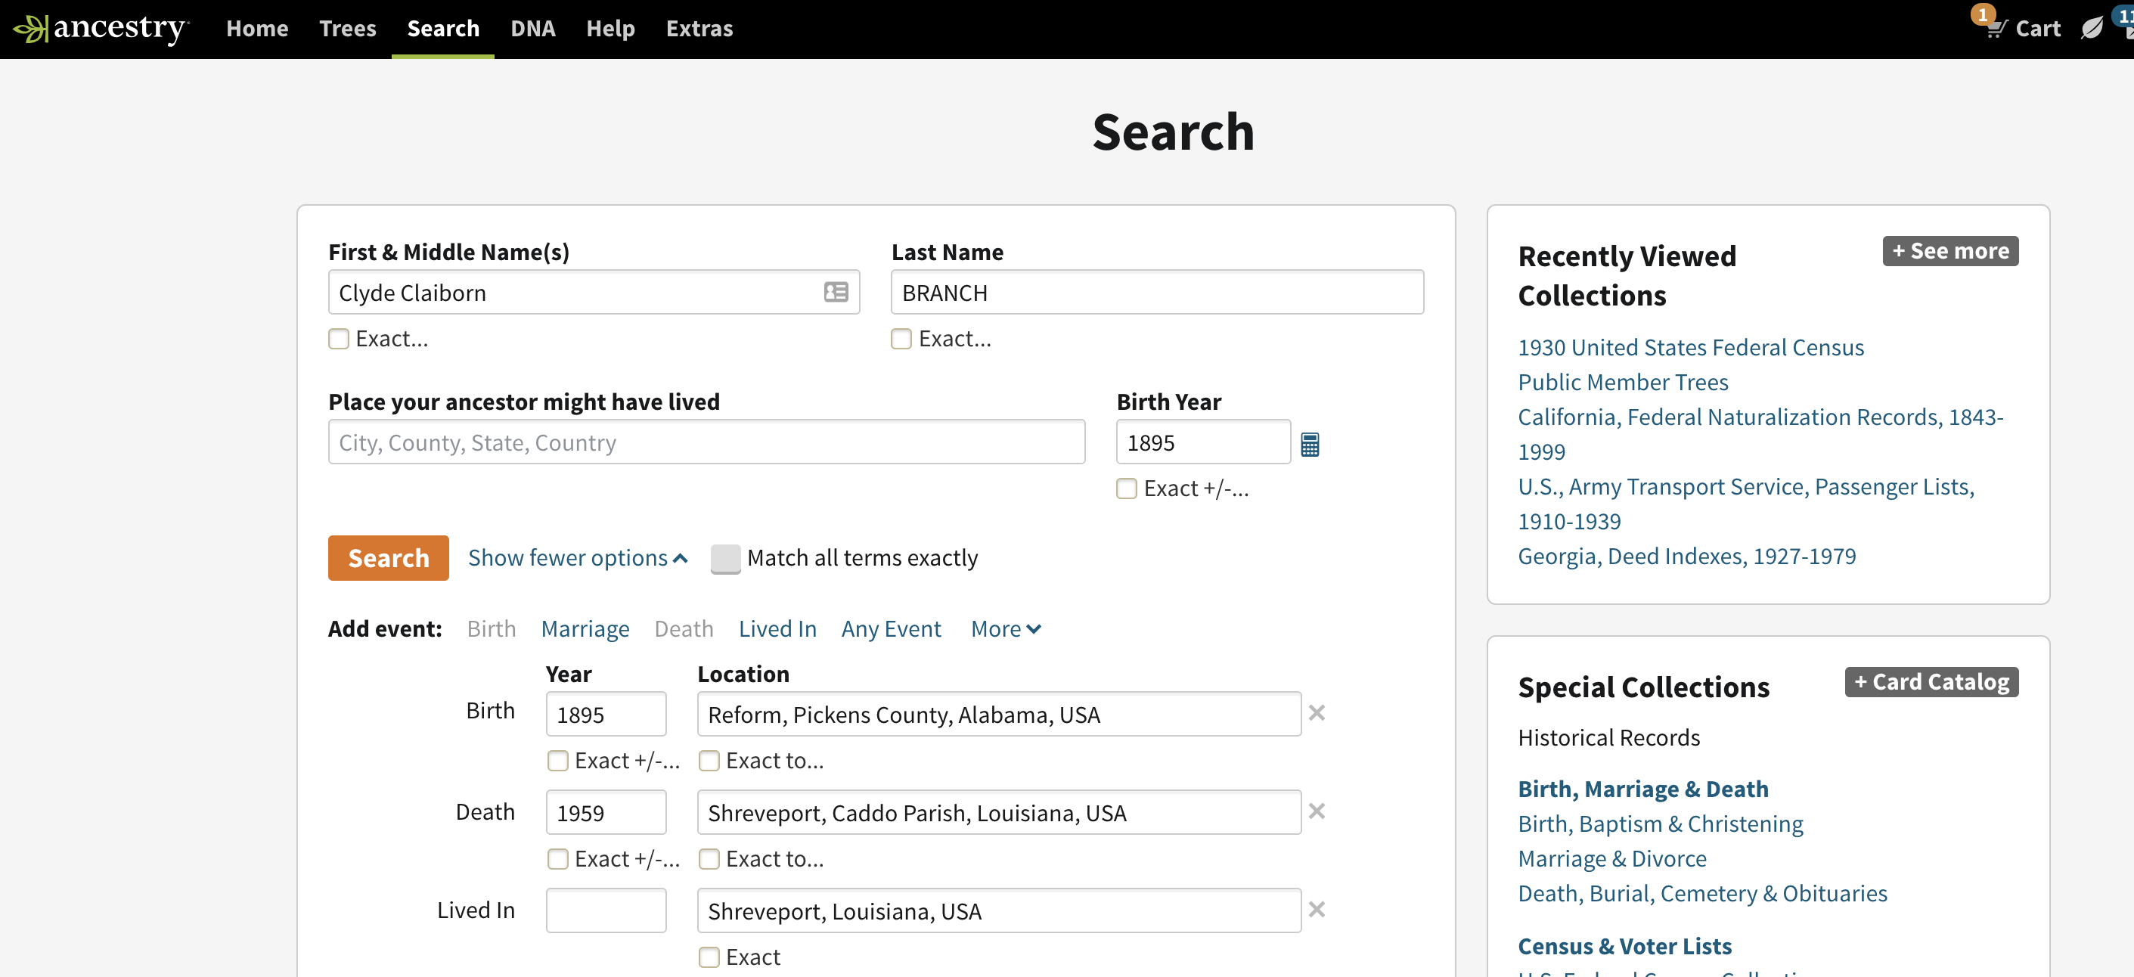
Sample Simple Search

Slide 27
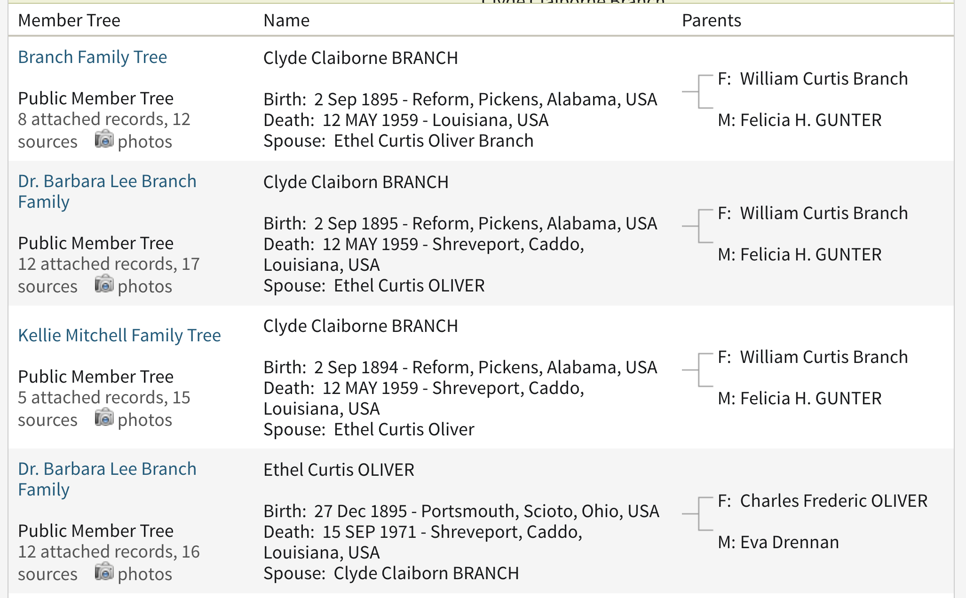
Family Tree Search
Click Hyperlink

Slide 28
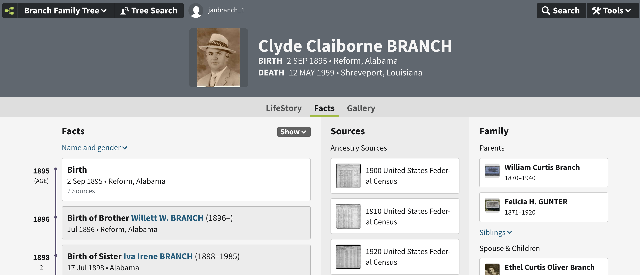
Sample Search Results

Slide 29
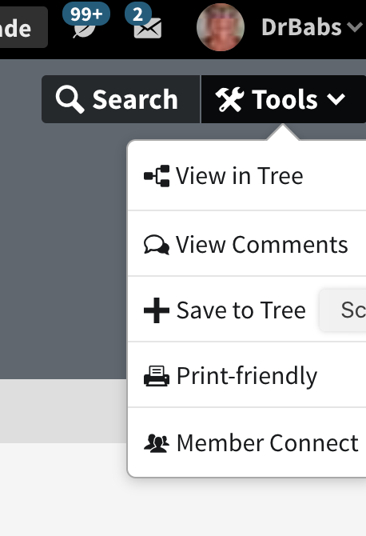
Sample Search Results
Save info from another tree to your tree.

Slide 30
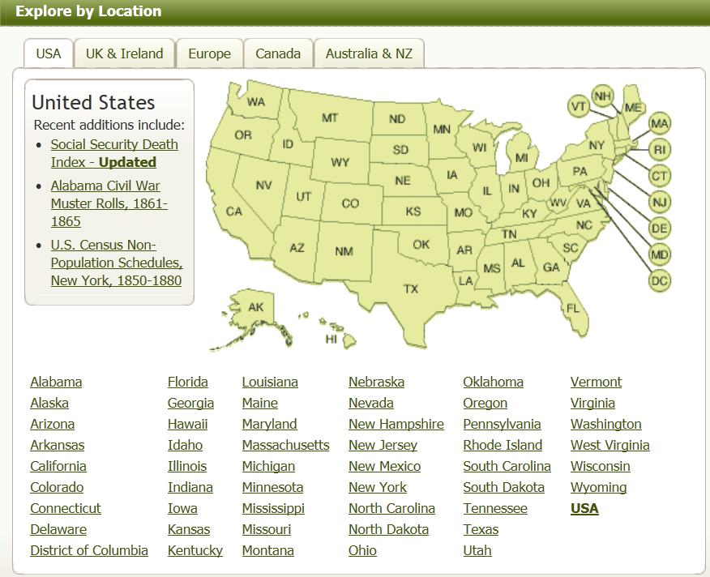
Explore by Location
Click

Slide 31
Searching with Keywords
Often, more data is found in an original record than the number of fields provided by a search template would indicate. If you do have additional information, you can enter this data in the keyword field in order to refine your search results. Using the keyword field like this is especially helpful if your ancestor has a common name and you are getting more results than you can easily review.

Slide 32
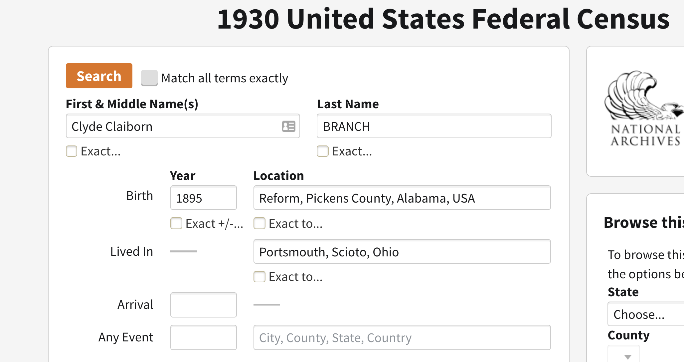
Search Results
Click on VIEW RECORD

Slide 33
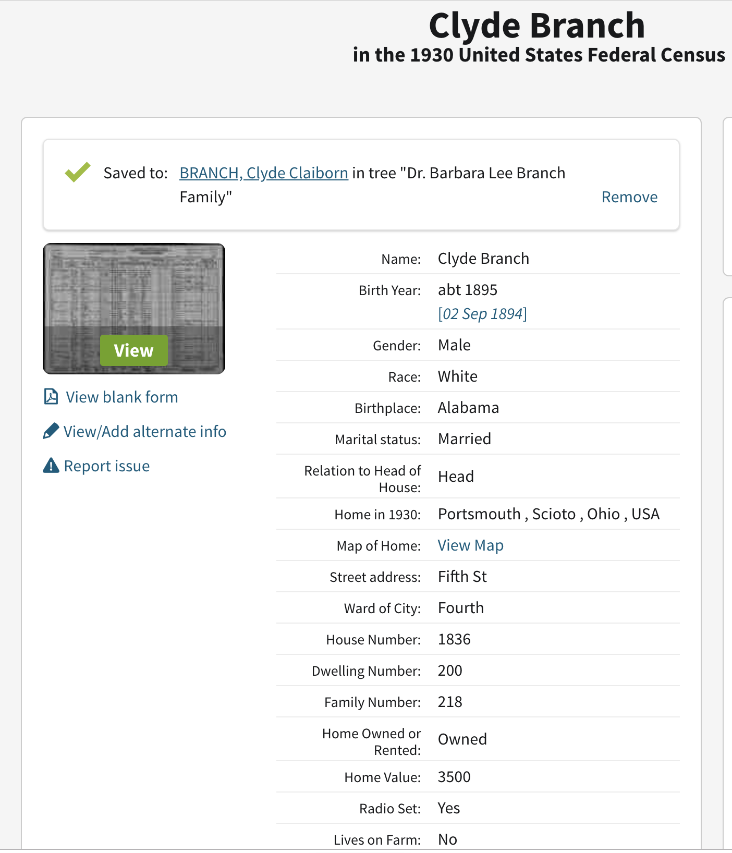
To View Original Record

Slide 34
Actual Census Record

Slide 35
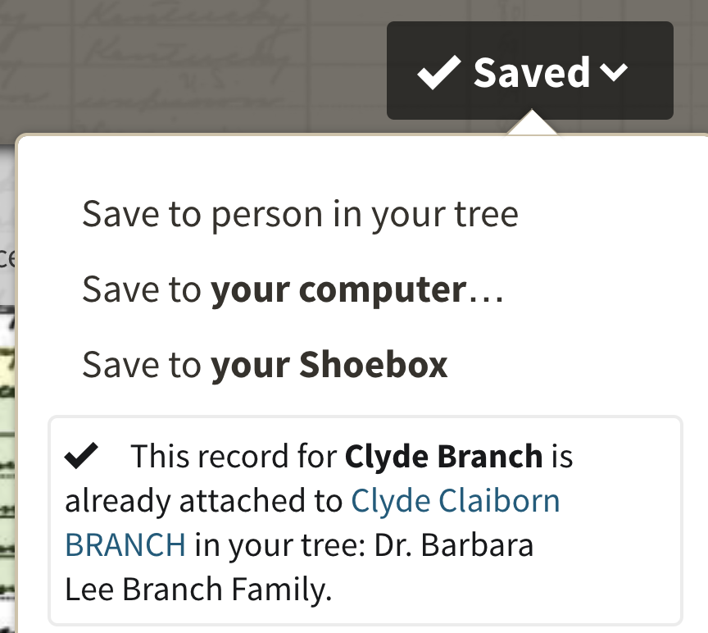
Saving Census Record
Click here for drop down menu

Slide 36
Saving the Census Record (2)
Choose Folder in Which to Save Census Image

Slide 37
Free Ancestry.com Databases
One of Ancestry.com's best kept secrets is that they have over 1,225 always-free databases. You may be asked to sign up for a free account, but the account is free, no strings attached.

Slide 38
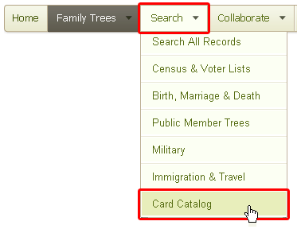
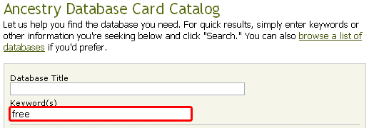
Finding Free Ancestry. Com Databases
Log into your ancestry.com account.
Hover your cursor over the SEARCH tab.
Select CARD CATALOG from the dropdown menu.
Type “FREE” in Keywords search box.

Slide 39
Other Features
Blog
Ancestry Academy Videos
Ancestry Community and Collaboration
Syncs with RootsMagic Software
Newspapers.com
Fold3.com - Military Records
Findagrave.com
World Research
Pro Genealogists
IPhone and Android apps

Slide 40
Ancestry.com’s DNA Testing
Ancestry.com has a DNA testing facility whereby you can discover your genetic genealogy simply by ordering a test kit and sending your DNA sample back to Ancestry.com. These tests are provided at a reasonable cost, and keep giving new information as more members take DNA tests.

Slide 41
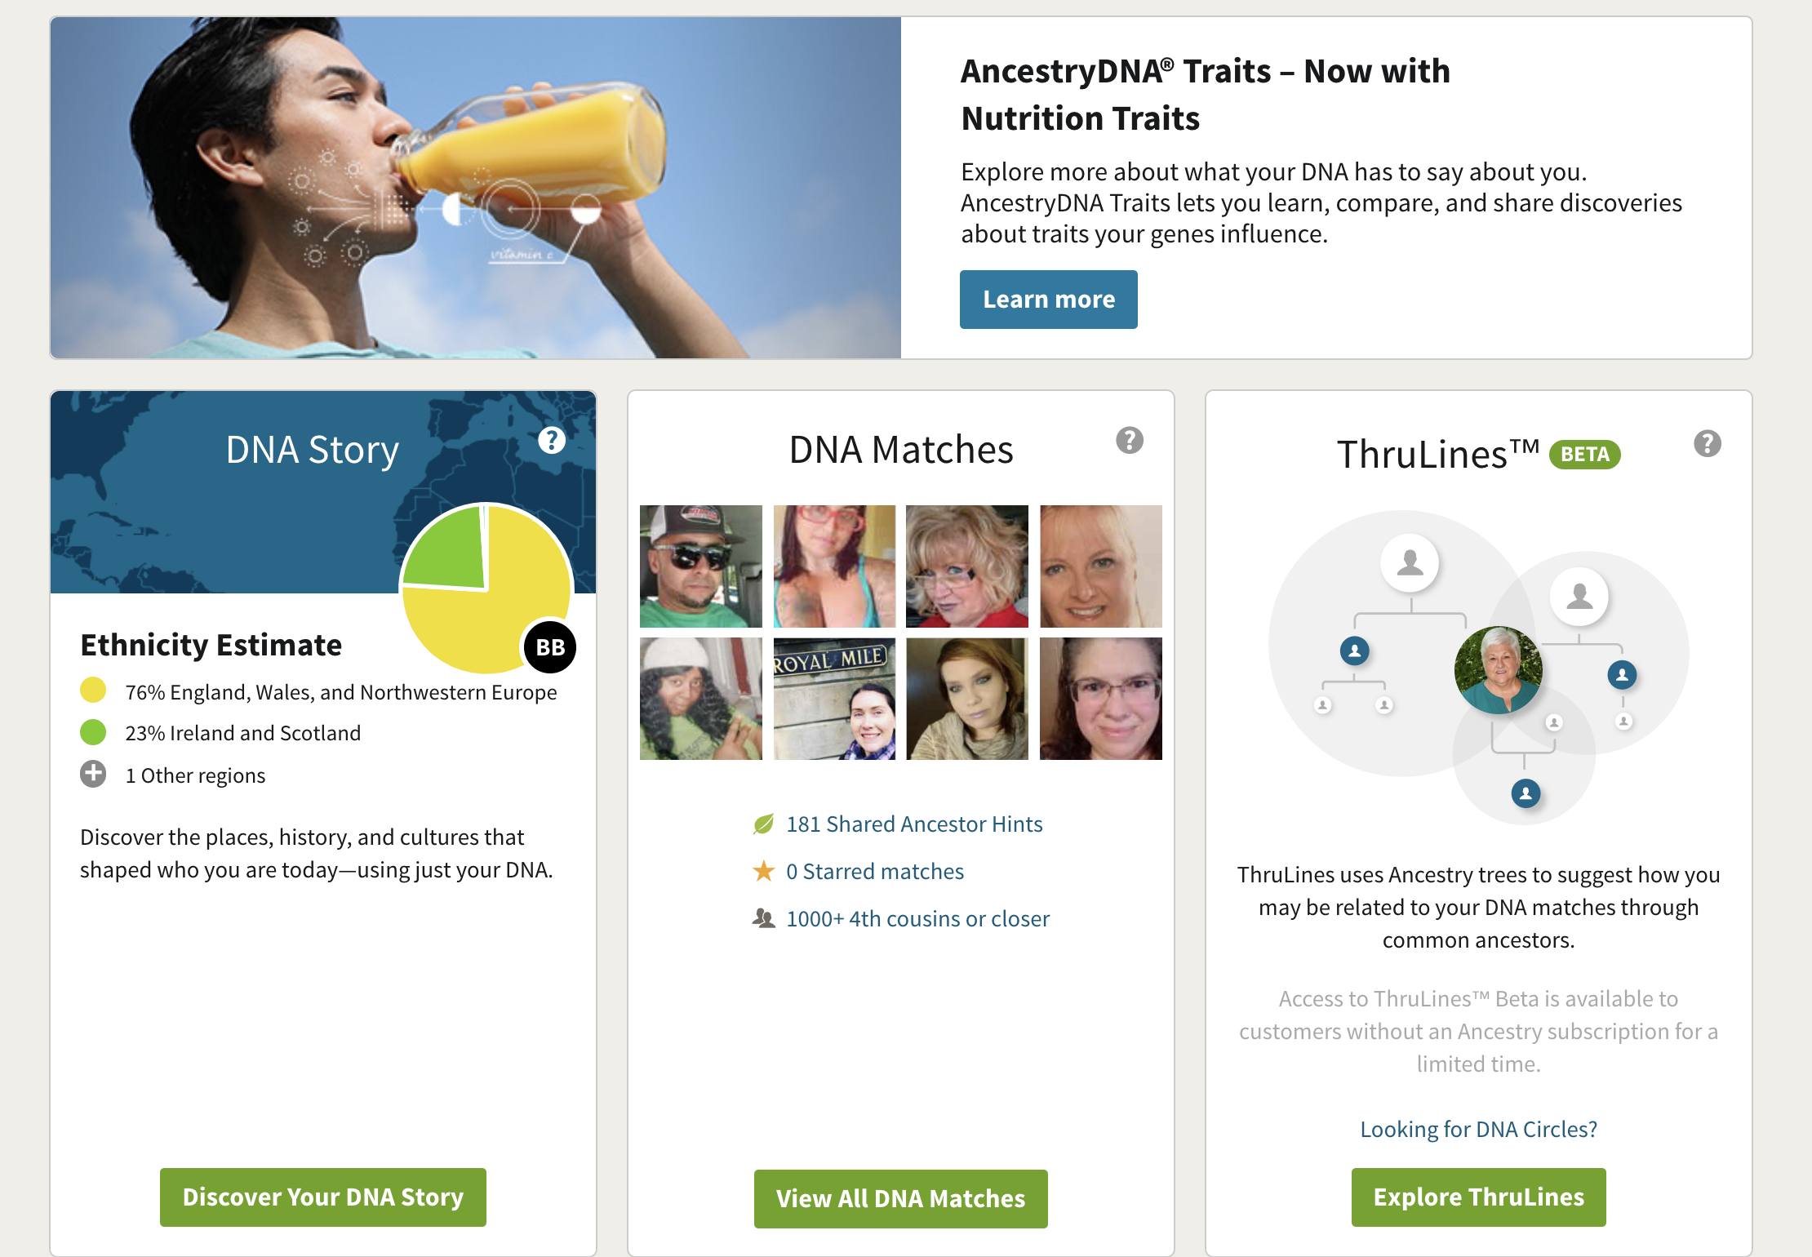
Ancestry.com’s “DNA”

Slide 42
Explore Ancestry.com

